Slide 1
充满我
Fill Me, Lord
矽谷生命河灵粮堂
系列7：奔向愛我的神 So I will run
曲词 Composer Lyrics:
吳文琛 Tim Goh

Slide 2
充满我
Fill Me, Lord
我的心 惟有祢 我的灵 渴慕祢
Lord, my heart longs for You
Lord, my soul waits for You
我全人 献给祢 以全心 赞美祢
All my mind, all my soul
Here to sing praise to You
1-V.1

Slide 3
充满我
Fill Me, Lord
举双手 敬拜祢 深深说 我爱祢
Lift my hands worship You
Want to say I love You
我的神 我的主 我渴望 亲近祢
Lord, my God, how I long
To get closer to You
1-V.2

Slide 4
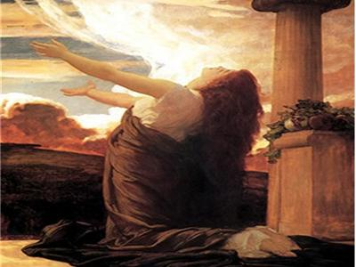
充满我
Fill Me, Lord
充满我 浇灌我
Fill me, Lord, quench me, Lord
使我灵得满溢
Fill my cup, make me whole
充满我 洁净我 更新我
Fill me, Lord, cleanse me, Lord, make me new
1-R.1

Slide 5
充满我
Fill Me, Lord
充满我 滋润我
Fill me, Lord, with Your love
让祢爱来围绕我
Let Your spirit hold me close
我一生 我一世 属于祢
I am Yours, all the days of my life
1-R.2

